Slide 1
Data Science Training Getting Started with Python & NumPy

Slide 2
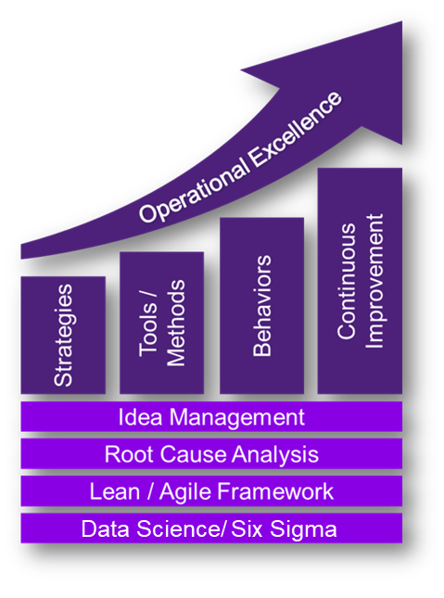


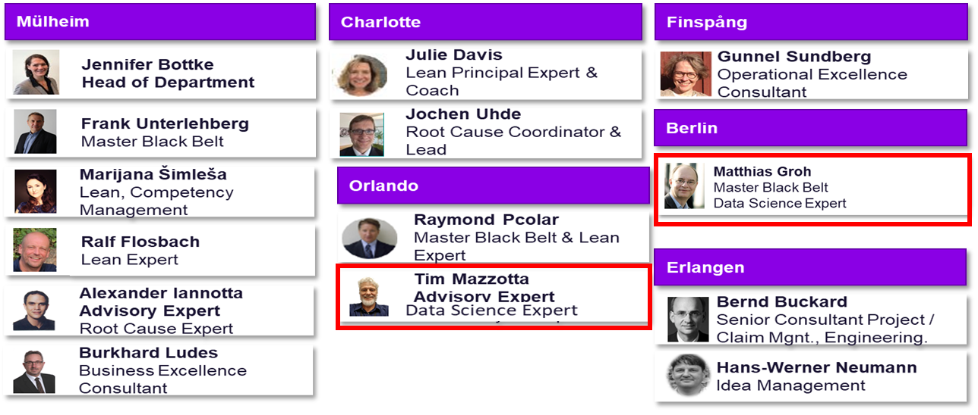
This training was developed for you by Data Science @ SE GP G QPI QM P Improvement Projects
We help your employees getting the skills for the digital future:
Global Data Science Skill Network (with Matt Bryan, LGT R&D)
Data Science and Machine Learning trainings (with several partners):
Currently 11 trainings developed and executed
Attended by >500 participants mostly from R&D
Analytic services in specific improvement projects
EAI CodeShare (with Thomas Buller, LGN R&D)
Data Science Lead Developers @ QPI QM P:
Matthias Groh Six Sigma Master Black Belt
Data Science Consultant
Tim Mazzotta Advisory Expert Data Science Expert
We help building the bridge between Data Science and daily engineering business.

Slide 3

How This Training Works
Experiment, we are all learning
DS0-> DS1->DS2->DS3 are prerequisits (enough to read through scripts)
New For DS2: "Transforming Data“ = free chapter 1 of "Data Manipulation with Pandas“ https://learn.datacamp.com/courses/data-manipulation-with-pandas
1x15 Min Break in each 2h block
Recording: high demand, few training seats
Based on interaction
Discussions, Exercises + Debriefs
Harder in Teams
If I should not call on you, please tell us now

Slide 4
Introduction
Name, Department
All prerequisites fulfilled? EnergyAI, knowledge of previous trainings (DS0->DS1->DS2->DS3)
Preexisting knowledge program, data science, statistics, Python, R, …
Expectations

Slide 5
The training

Slide 6
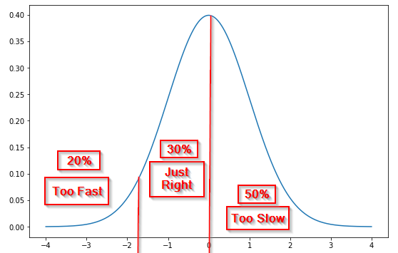
Goal Data Science Workshops: Basic understanding how to use Python and EnergyAI to access power plant data
Workshop Module | Agenda | Goals | Our approach to teaching:
DS 1 Python Basics | Jupyter Notebook Intro Lists, Object Localization Loops, Dictionaries, If Definitions Classes/ Objects/ Methods Intro to NumPy/ ND-Arrays | Target audience (all modules): Any engineer who needs to analyze big data In particular engineers verifying assumptions with power plant data Prerequisites: Basic programming knowledge or DS0 DS1 for DS2, DS2 for DS3 or reading through the scripts New For DS2: "Transforming Data“ = free chapter 1 of "Data Manipulation with Pandas" https://learn.datacamp.com/courses/data-manipulation-with-pandas Teaching goals (all modules): First steps to learn the topic is taken. Basic concepts are understood ->just enough to keep learning from online sources. Everybody learns in the workshop, also trainers. This is a teaching “Minimal Viable Product” | Handling of questions: For understanding questions ask right away For major problems go to separate helpline Teams meeting: one of the teachers will join you as a coach Expert discussions moved to break or afterwards With a wide range of participant’s knowledge: Target speed is for 20% too fast / for 50% too slow
DS2 Python: Pandas and Seaborn | Recap Handling Nans Resample and Fill Calculation with dataframes PickleFormat Connecting dataframes Intro Visualization with Seaborn
DS 3 Data Pulling in Energy AI | Intro Data Pulling Time Interval Plants, Units and Signals Period, Aggregation Fill, Thresholds, Poststresholds Plotting with Seaborn (cont.) Examples

Slide 7
Our Focus in the Digitalization World is Data Science
Our Focus
Data Science
Business Intelligence
Focus on quantitative data
For Example:
Power plant sensor data
Manufacturing data
Component design analysis data (FE, CFD, CHT, …)
Test rig data
Focus on qualitative data
For Example:
Manufacturing and supply data in SAP
Qualitative fleet data (Fleet Intelligence)
PCM
Of course everybody needs a bit of both data types, but without focusing, no one gets anywhere…

Slide 8
Definition Data Science
Data science is a multi-disciplinary field that uses scientific methods, processes, algorithms and systems to extract knowledge and insights from structured and unstructured data. ^{[1]}
Technical Domain Knowhow
Data Engineer
Math, Stats, Algorithms
Software Engineering
Data Scientist
Data Analyst
Data Communication
Data science includes “new” (Machine Learning) and “old” (conventional analytics).
[1] en.wikipedia.org/wiki/Data_science

Slide 9
Python - a short overview

Slide 10
Basic Elements - Data Structures in Python (Grey), Numpy (Green) and Pandas (Orange)
 | Description | Useful for… | Example
Lists | Store collection of heterogeneous items – immutable and mutable objects | Simple listing Special programming techniques (Stacks, Queue, Graphs, Trees) | [item, item, item]
Dictionaries | Collection of key-value pairs Key: immutable objects Value: heterogeneous items – immutable and mutable objects | Creating loops to do the same operation on many dataset | {key1:item1, key2:item2}
Files | Store and retrieve previously stored information |  | .csv, .hdf5, .xlsx
Tuples | Tuples are data structures in which the content can not be changed after creation (no deletion, add or edit) | Prevents data manipulation | (item, item, item)
Sets | Collection of unique objects | Creating lists that only hold unique values Helpful when going through huge dataset | {item, item, item}
Numpy ND-Arrays | Store collection of data of the same type | Dealing with large collection of homogeneous data types: easier to use, faster and uses lesser memory than lists Support vectorized operations Work efficiently with large datasets with lots of empty cells | [[1. 1. 2.] [3. 5. 8.] [5. 3. 2.]]
Dataframes | 2-dimensional labeled data structure Columns don’t have to have the same data type | Data mining / manipulation Labeling Multiindexing | Like this table
Series | One-dimensional labeled array capable of holding any data types | Axis labels | a 1 b 2 c 3
Source: www.datacamp.com, pandas.pydata.org; Also see: https://www.datacamp.com/community/tutorials/data-structures-python

Slide 11
A Selection of Important Libraries in Python
Category | Name | Description | Link
Data Handling Libraries | Numpy | Basic Library for scientific computing in Python (linear algebra, numerical functionalities etc.) | https://numpy.org/
 | Pandas | Package especially built for data analysis | https://pandas.pydata.org/
 | Scipy | Mathematical and engineering functions (e.g. optimization and fits, numerical integration…) | https://www.scipy.org/
Plotting Libraries | Matplotlib | 2D plotting library for basic plotting | https://matplotlib.org/
 | Seaborn | Is built on top of matplotlib, thus offers more functionalities | https://seaborn.pydata.org/
 | Plotly | Is built for interactive graphs | https://plot.ly/python/
Machine Learning Libraries | TensorFlow | For machine learning applications (e.g. voice recognition) | https://www.tensorflow.org/
 | SciKit-Learn | For machine learning applications (e.g. regression models, clustering, vector-machines…) | https://scikit-learn.org/stable/
Other Useful Libraries | Time | Provides all time-related functions | https://docs.python.org/3/library/time.html
 | Sys | For interaction with interpreter (advanced) | https://docs.python.org/3/library/sys.html

Slide 12
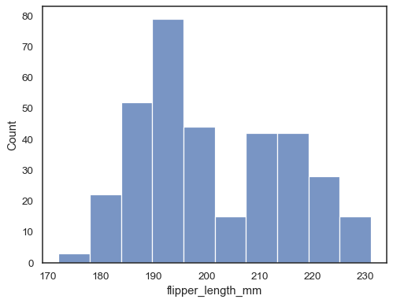
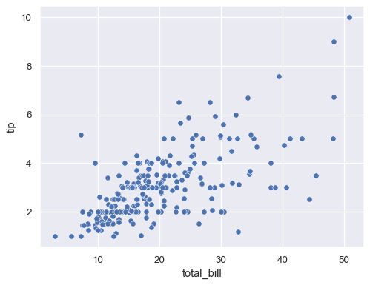
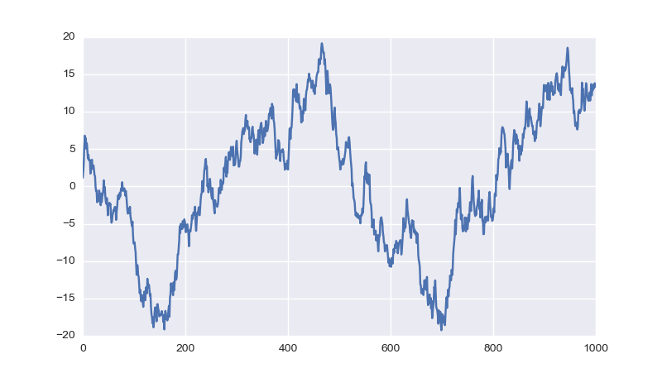
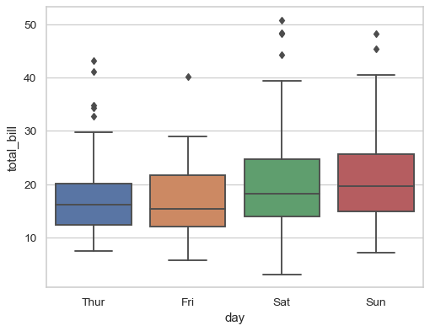
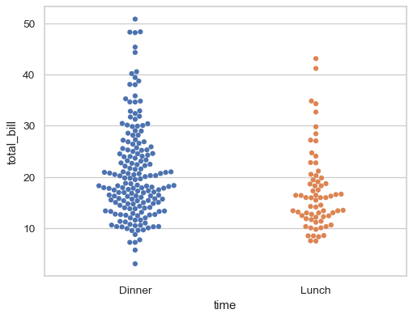
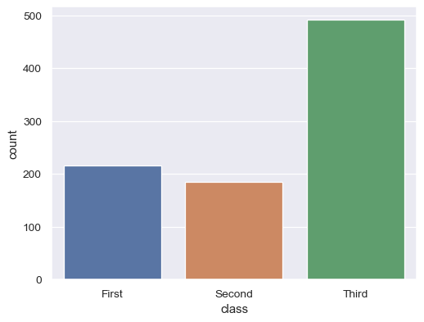
Overview: Essential Graphs of Seaborn
Name | In SNS | Useful for | Plot | Relative to … | Target variable
Histogram | .histplot() | Central tendency Spread Distribution Outliers |  |  | Continuous data
Scatterplot | .relplot() X-Axis is continuous | Correlation Outliers |  | … other continuous data
Lineplot |  | Time effect Spread Outliers |  | … time
Boxplot | .catplot() X-Axis is categorical | Group effects Central tendency Spread Distribution Outliers |  | … categorical data
Swarmplot
Countplot |  | Counts group effects |  | … categorical data | Quantitative data

Slide 13
If you want to use Python at SE after this class…
Power and Gas – Large Gas Turbines, Generators

Slide 14
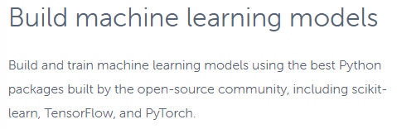
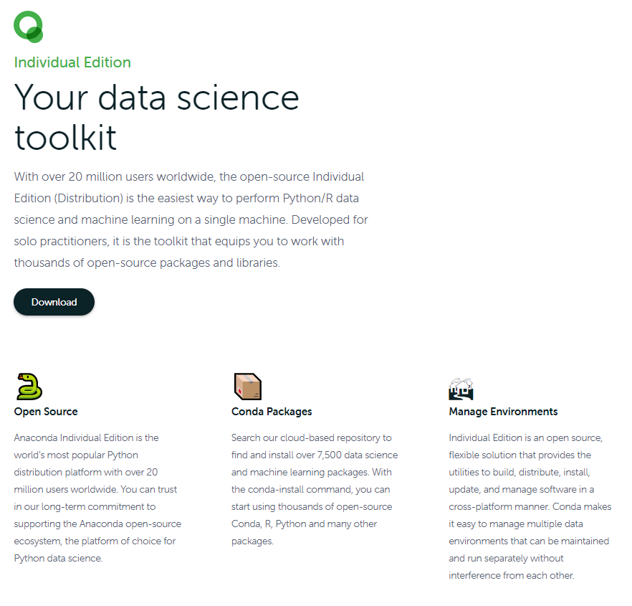
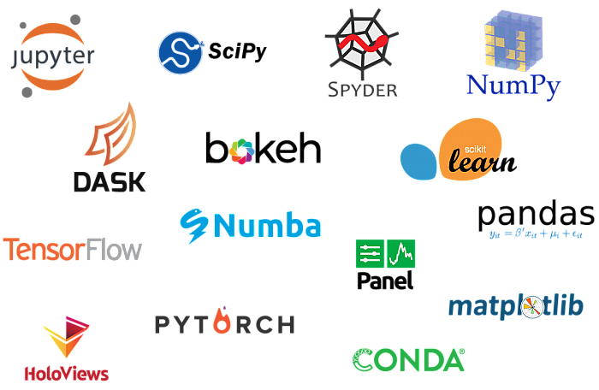
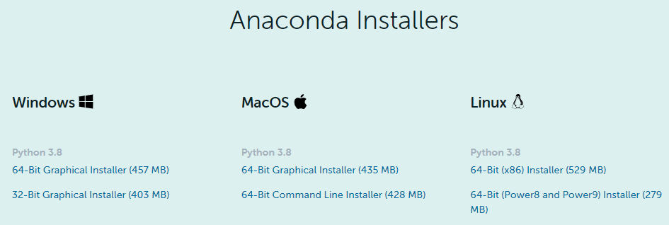
The Classical Package for Python: Anaconda (not an official SE-software for download, but often just downloaded anyway)
https://www.anaconda.com/distribution/

Slide 15
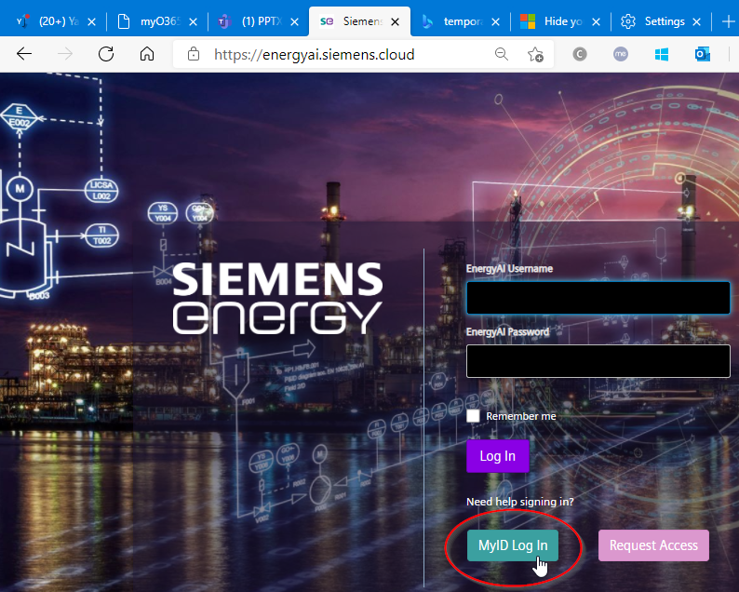
A good and “correct” way around Anaconda at ES is EnergyAI: Apply at: https://energyai.siemens-energy.cloud/ For problems contact: contact@energyai.siemens-energy.cloud
Why EnergyAI?
The EnergyAI - Analysis platform…
…offers an efficient interface to handle large data requests on multiple plants or units
…enables the user to perform postprocessing on-the-fly, without further data handling steps
…provides a standardized GPN System to address signals across all plants and units
…executes all operations outsourced on a server and makes results available for client

Slide 16
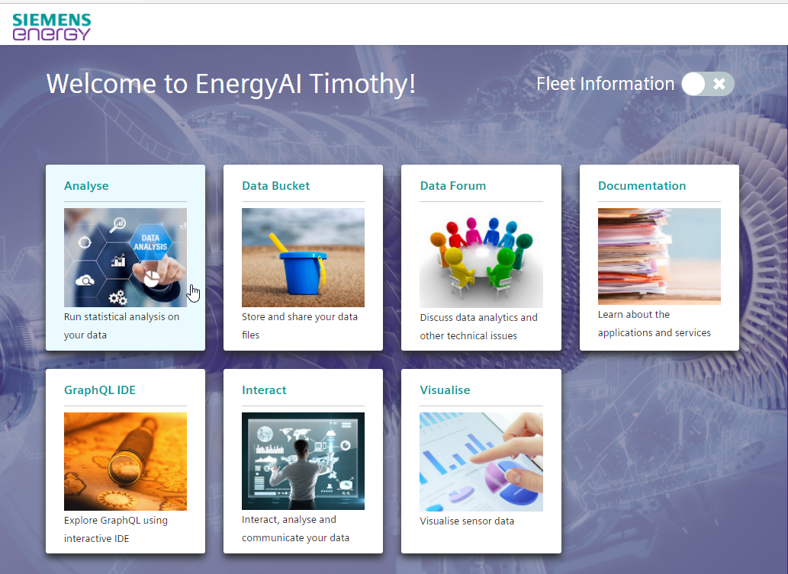
Go to “Analyse”
https://energyai.siemens-energy.cloud/
https://analyse.energyai.siemens-energy.cloud/

Slide 17
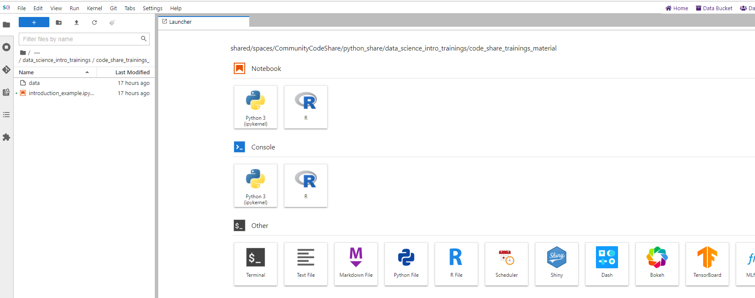
Analyse Layout
File System
Script-based (JupyterLab)
Console-based
more functionalities

Slide 18
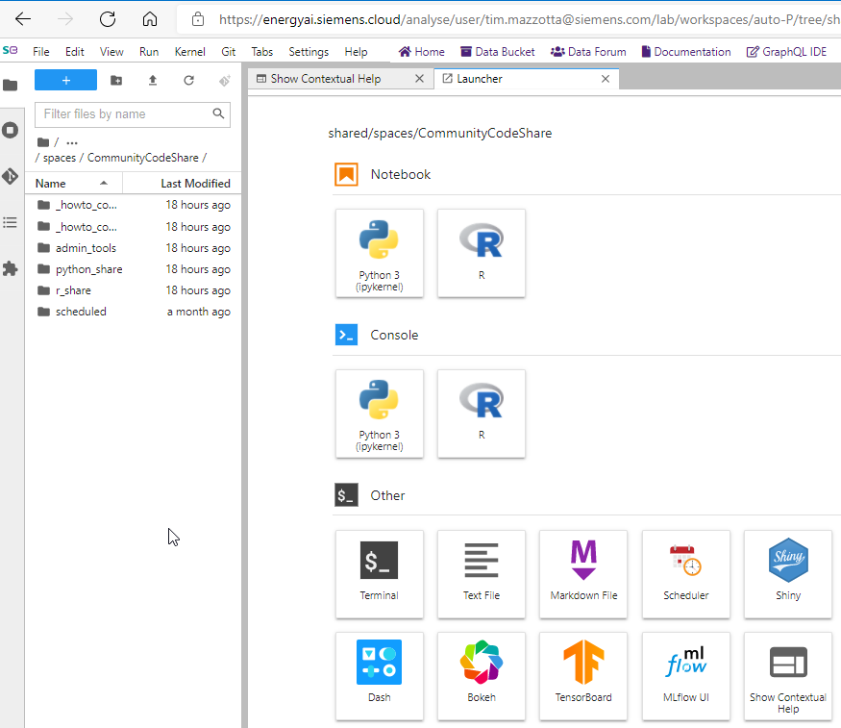
First Steps – File System
Hierarchical File System as on Windows
In ‘/shared/groups‘ , it can be worked in groups (group folder has to be requested)
In ‘/shared/users‘ some scripts of other users are visible (copy script in your shared folder to make it visible for others)
Go to: ‘/shared/demos‘ for several demos on the usage of the datahub with R or Python
Go to: ‘/shared/spaces/CommunityCodeShare‘ for EnergyAI CodeShare projects
Repositories from GitHub can be embedded in folders to simultaneously work on scripts (recommended)
Single Click:
File system icon to navigate the tree
Single Click on:
Show Contextual Help
Double Click:
Folders/Files to open

